Slide 1

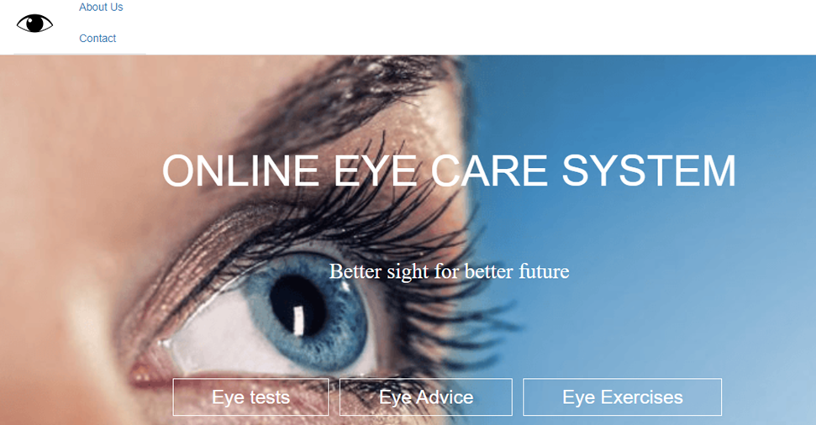
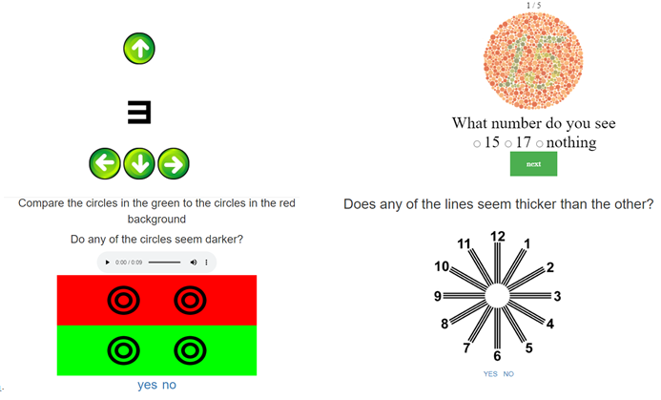
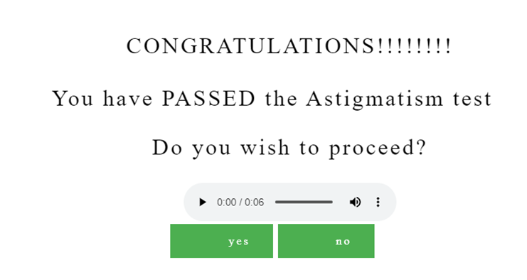
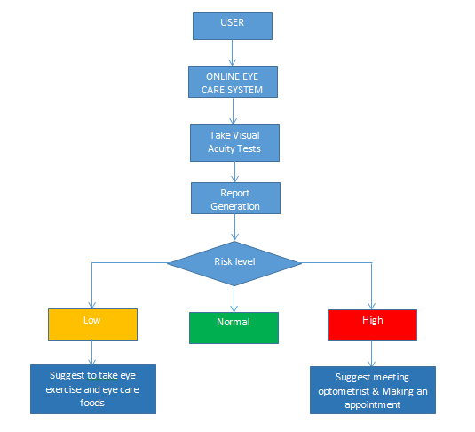
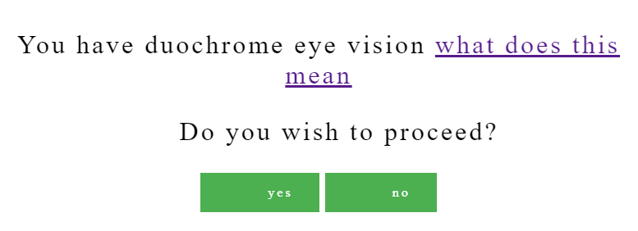
ONLINE EYE CARE SYSTEM
Introduction
Results
Online eye care system is a special website which makes you aware of your eye problems by making you take test in various sight tests like Visual Acuity Test, Color Variation Test, Contrast Vision Test, Amsler Grid Test, E & C Tests.
Eye check-up application users have to register or login to this application. It can detect your Eye problems by asking few questions like doctors. User answer the question the site will give suggestion about problem.
Motivation
Now a Days with the development technologies in the areas of web app development that we use in our daily life. This paper proposes an eye care system that makes use of the basic tests and detection for performing basic visual test in the computer using computer vision.
Scope of the Project
Home page
The main objective of this project is to bring a full-fledged web based eye test systems. visual activity test are maintained in the database so it makes the task easier. provide suggestion easily. The project aims to eye check-up application can detect your Visual acuity and the site will given results about your vision ability.
Methodology
For an efficient eye test system, a three tier organization structure has been recommended. Details of this Bayesian hierarchical modeling approach, the Stan modeling code, and the covariates used for each model are given in the eye care system. We fitted six separate mixed-effects models for the following causes: cataract, glaucoma, age-related macular degeneration, diabetic retinopathy, corneal opacity, and other. The models include terms adjusting for age, sex, best-corrected versus presenting vision, urban, and whether or not the study was nationally representative.
ER diagram:
An entity-relationship ERD, also called an entity relationship model, is the entities' graphical representation with each other relationships. ER Diagrams are used typically in computing regarding the data organization within information systems.
Vision Tests
Test Results
Suggestions
Conclusion
It is concluded that the web application works well and satisfy the end users. The application is simultaneously accessed from more than one system. This project is to bring a full-fledged web based eye test systems. This system enhances the accuracy based on the users need. Fast, clear and legible reports can be generated without any ambiguity.
There is scope for future development of this project. The world of computer fields is not static; it is always subject to be dynamic. It has future scope. Online Eye care system is to made for all the peoples have to check their eye test in online.
References
[1] Yeung WK, Dawes P, Pye A, Neil M, Aslam T, Dickinson C, et al. “eHealth tools for the self-testing of visual acuity”
[2] Anna Pavlina Charalambous , Annie Pye , Wai Kent Yeung , Iracema Leroi , Malcolm Neil , Chryssoula Thodi , Piers Dawes:”Tools for App- and Web-Based Self-Testing of Visual Impairment”

